Slide 1
Analysis of ECal Lumi Counters
Omar Sayeed Saimum [Saimum]
omars.saimum@kaist.ac.kr/cern.ch
3rd year undergraduate student
Dept. of Physics, KAIST, Daejeon, South Korea
Intern, Luminosity group of LHCb, LLR, Ecole Polytechnique, France
2nd November 2023

Slide 2
Info on the Data & the Filling Scheme
May Mu Scan -> Fill: 8782
Contains 1773 bbs, 601 bes and ebs, and 589 ees
Bunch trains; short ee, be, eb trains; both ee and be after bb.
June Mu Scan -> Fill: 9007
Contains 16 bbs, 124 bes and ebs, and 3300 ees
No bunch trains; Long ee trains; only ee appears after bb.
Only 29 kHz lines of HLT1 are analyzed.

Slide 3
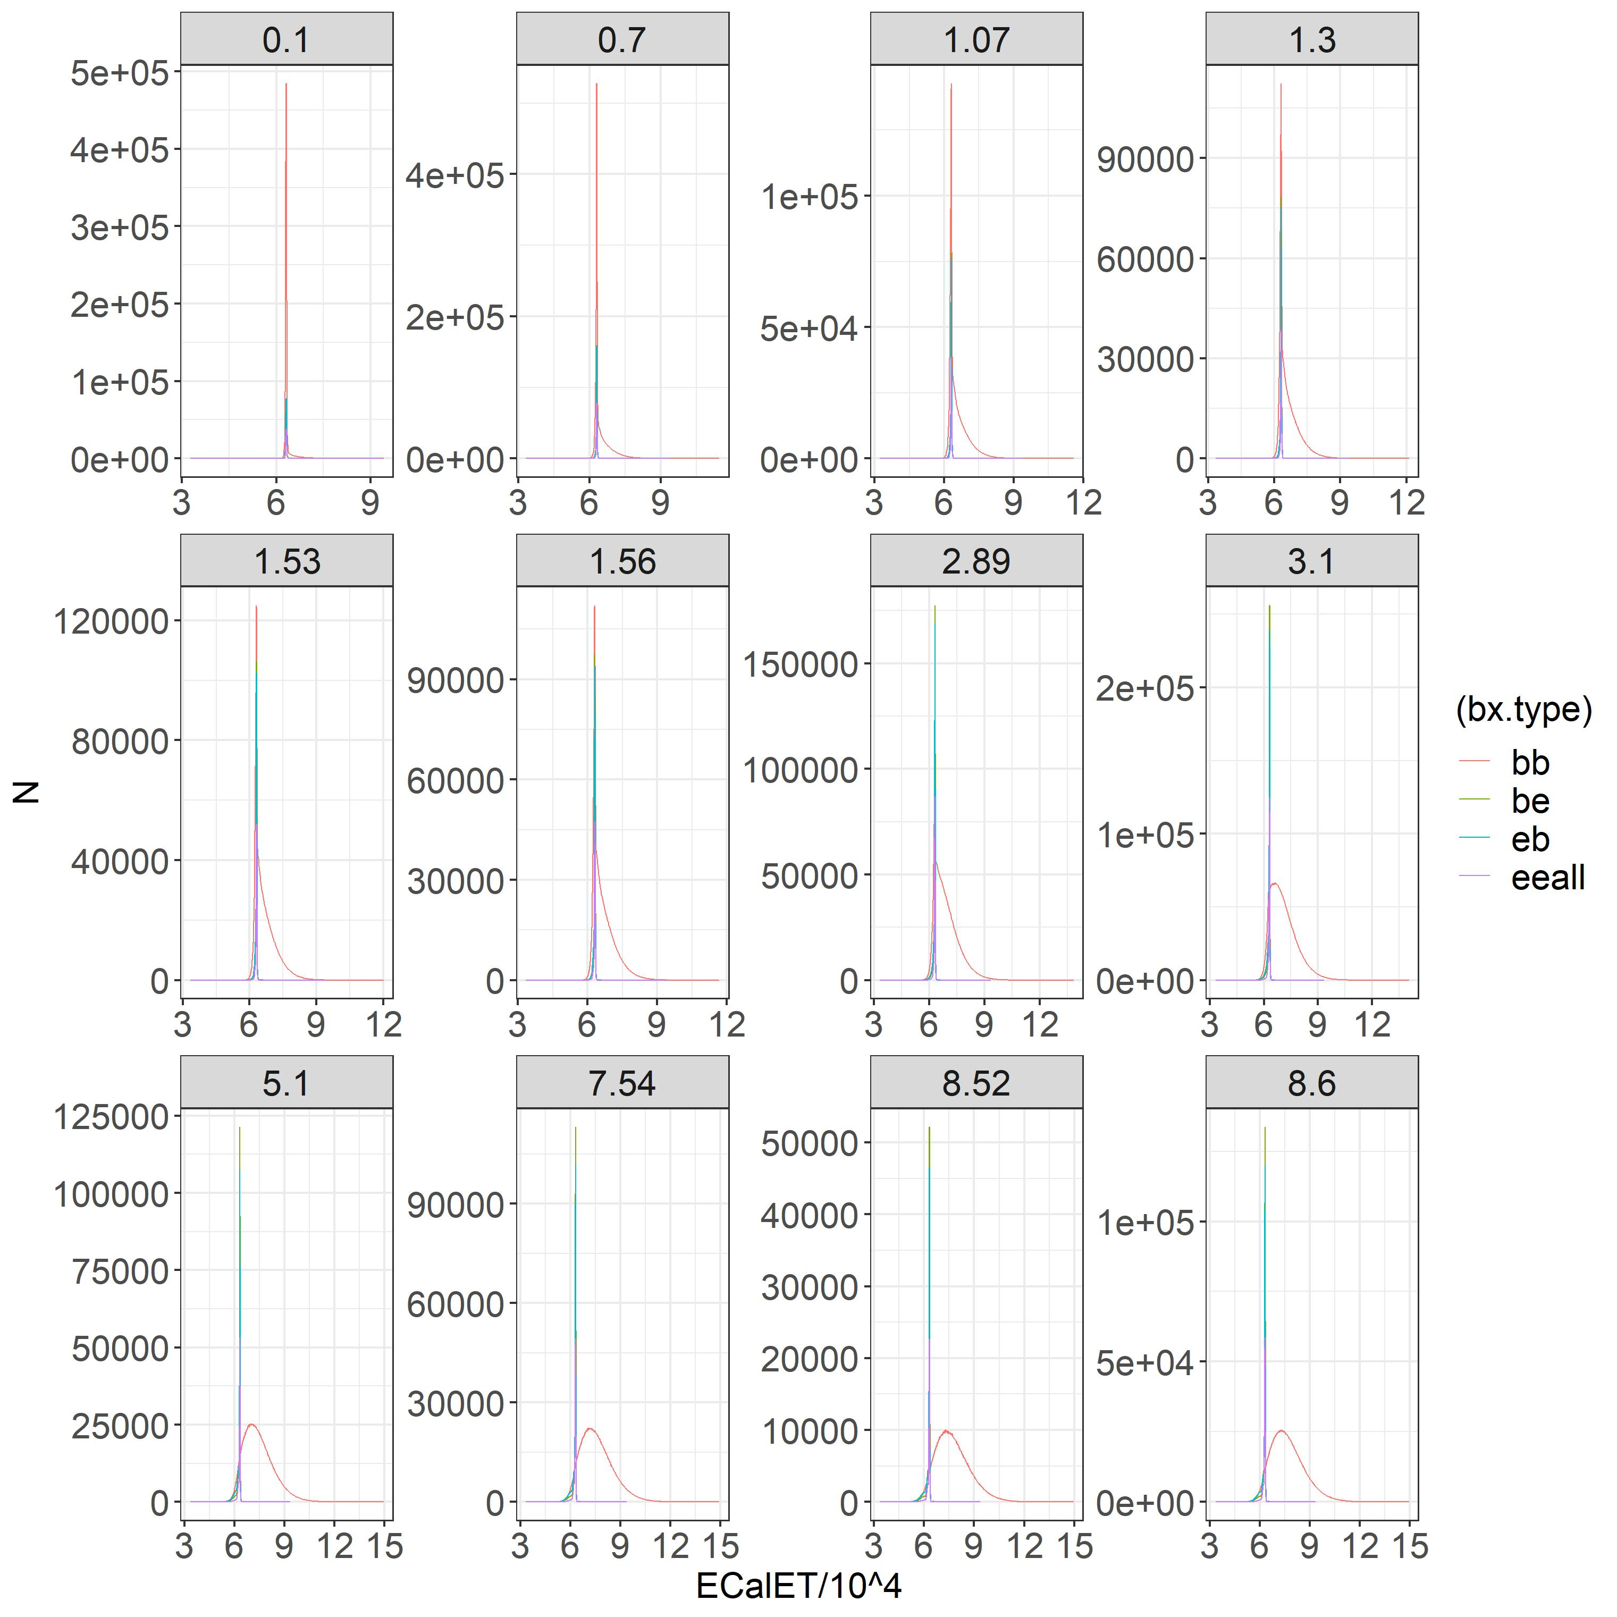
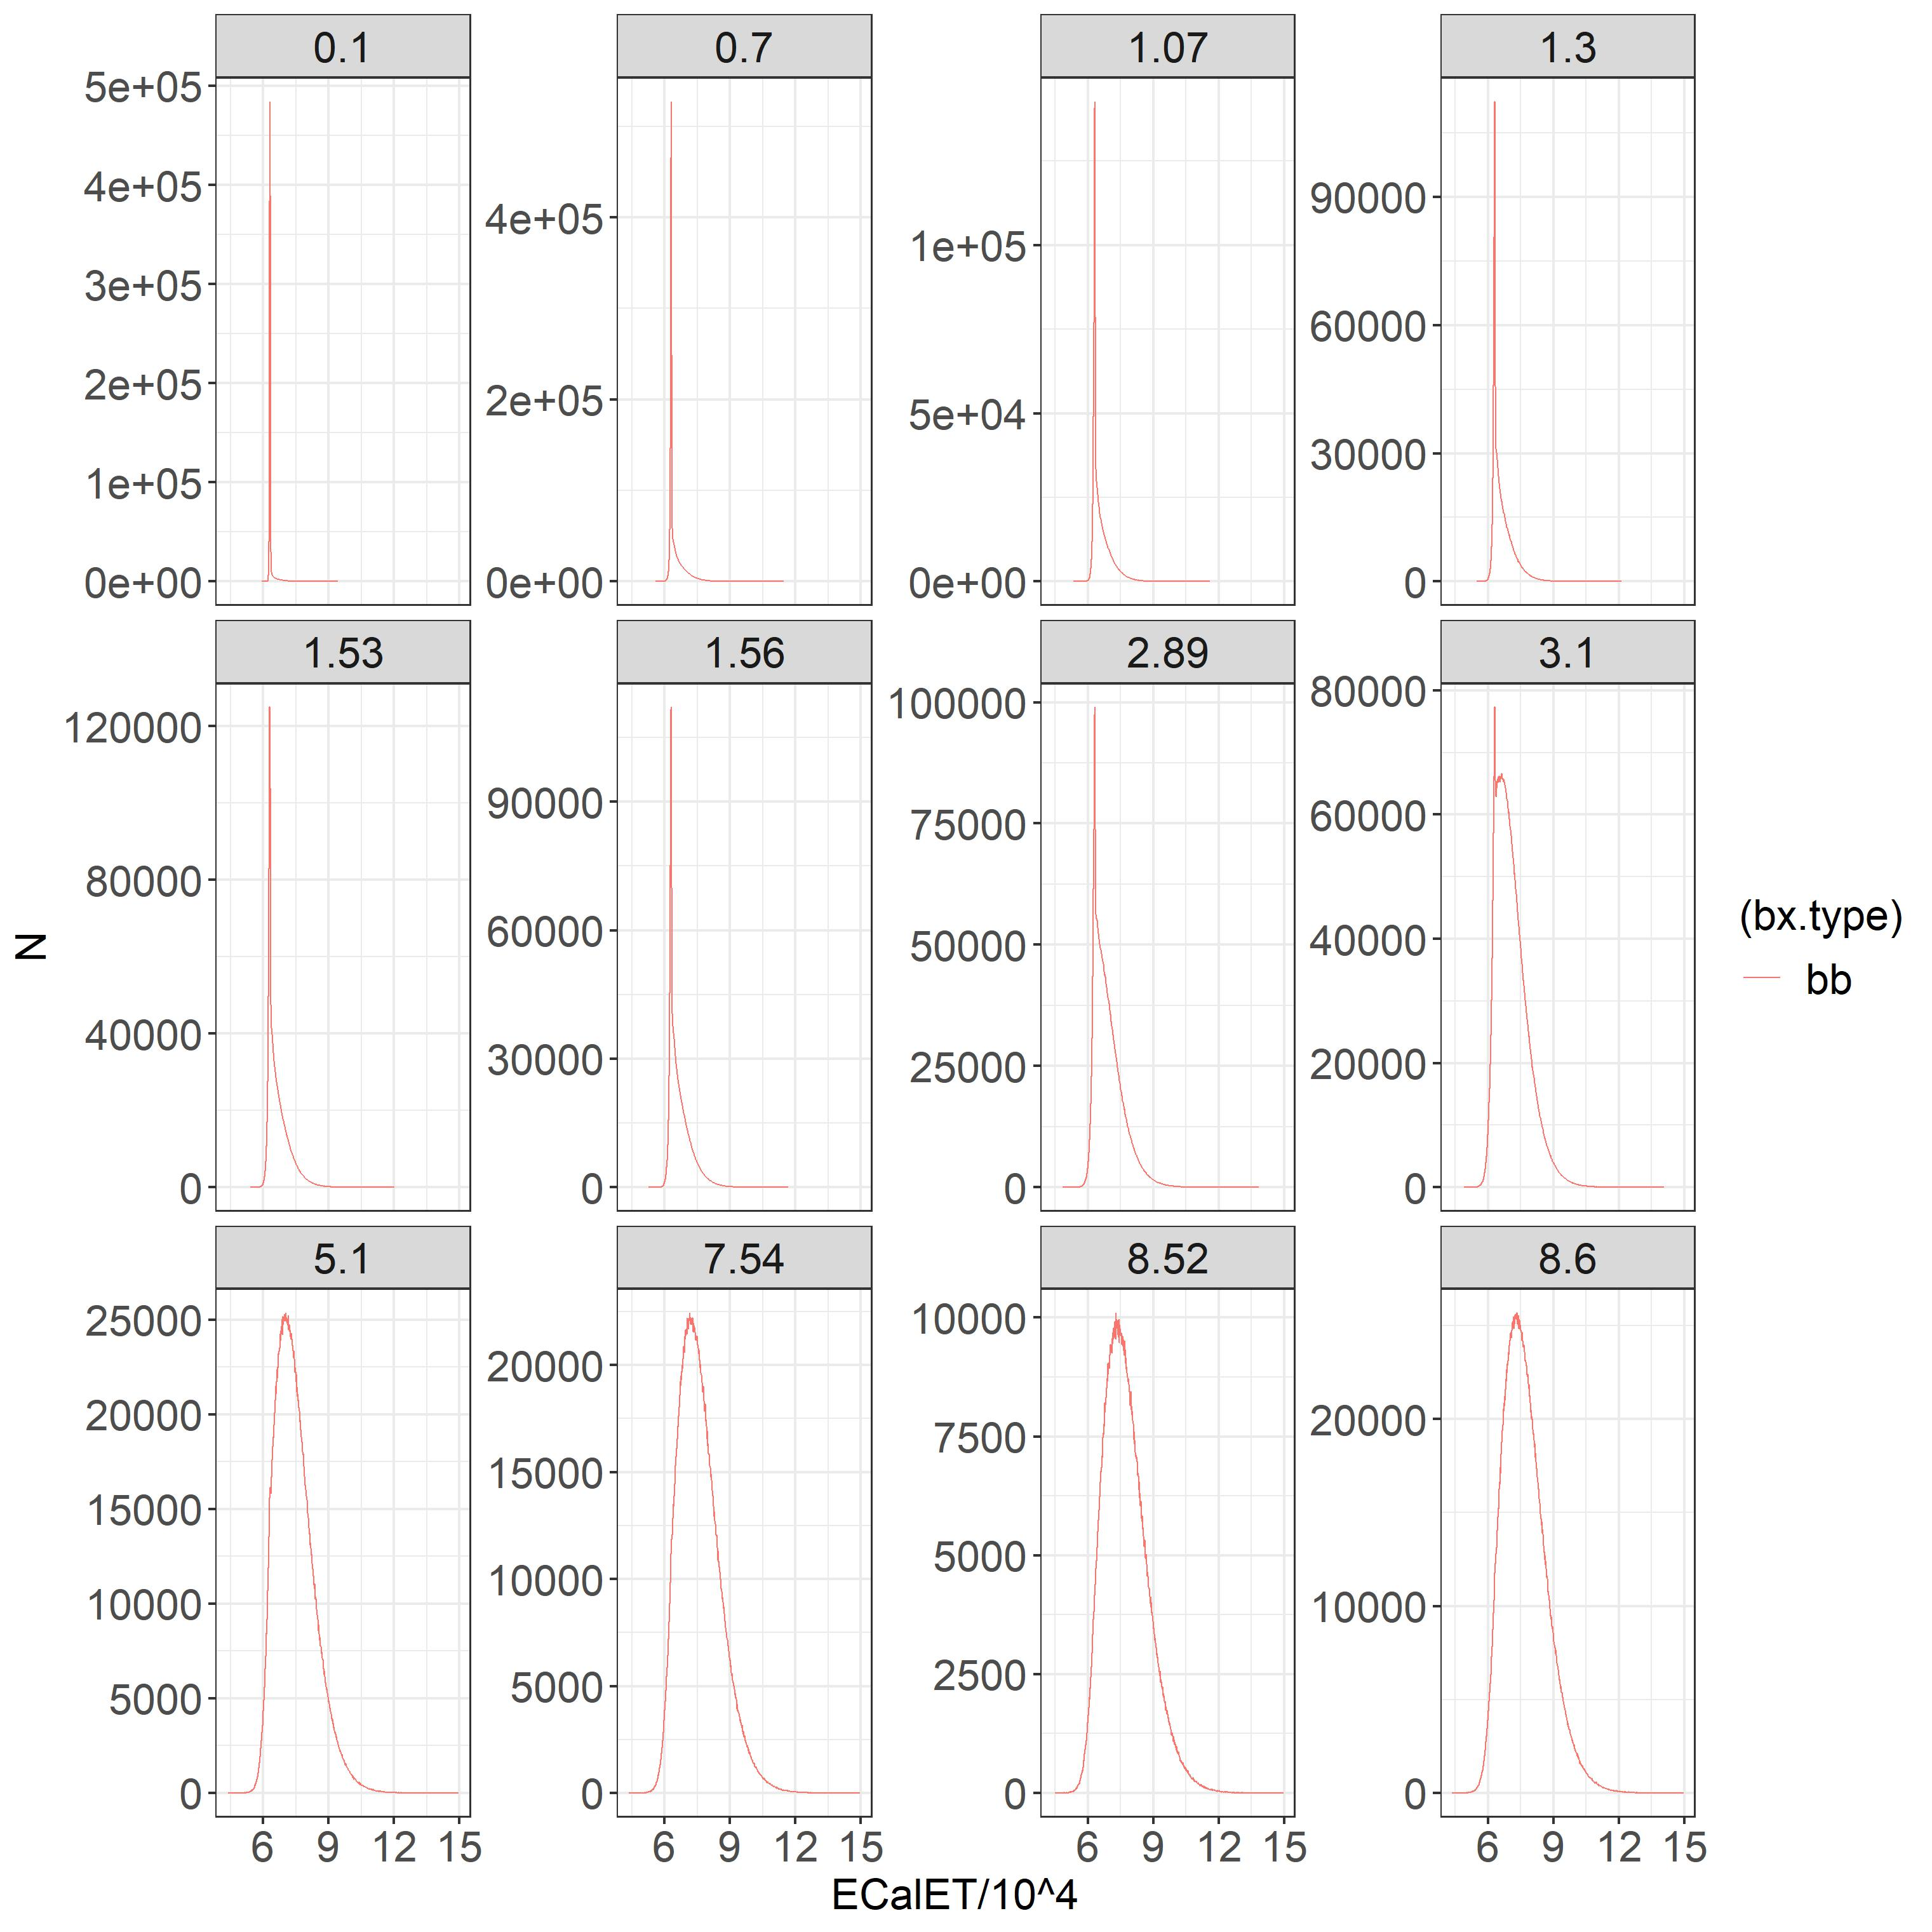
ECalET Spectrum for May MuScan
There is a ‘negative tail’ depending on mu
Indicates an issue with pedestal subtraction
bb

Slide 4
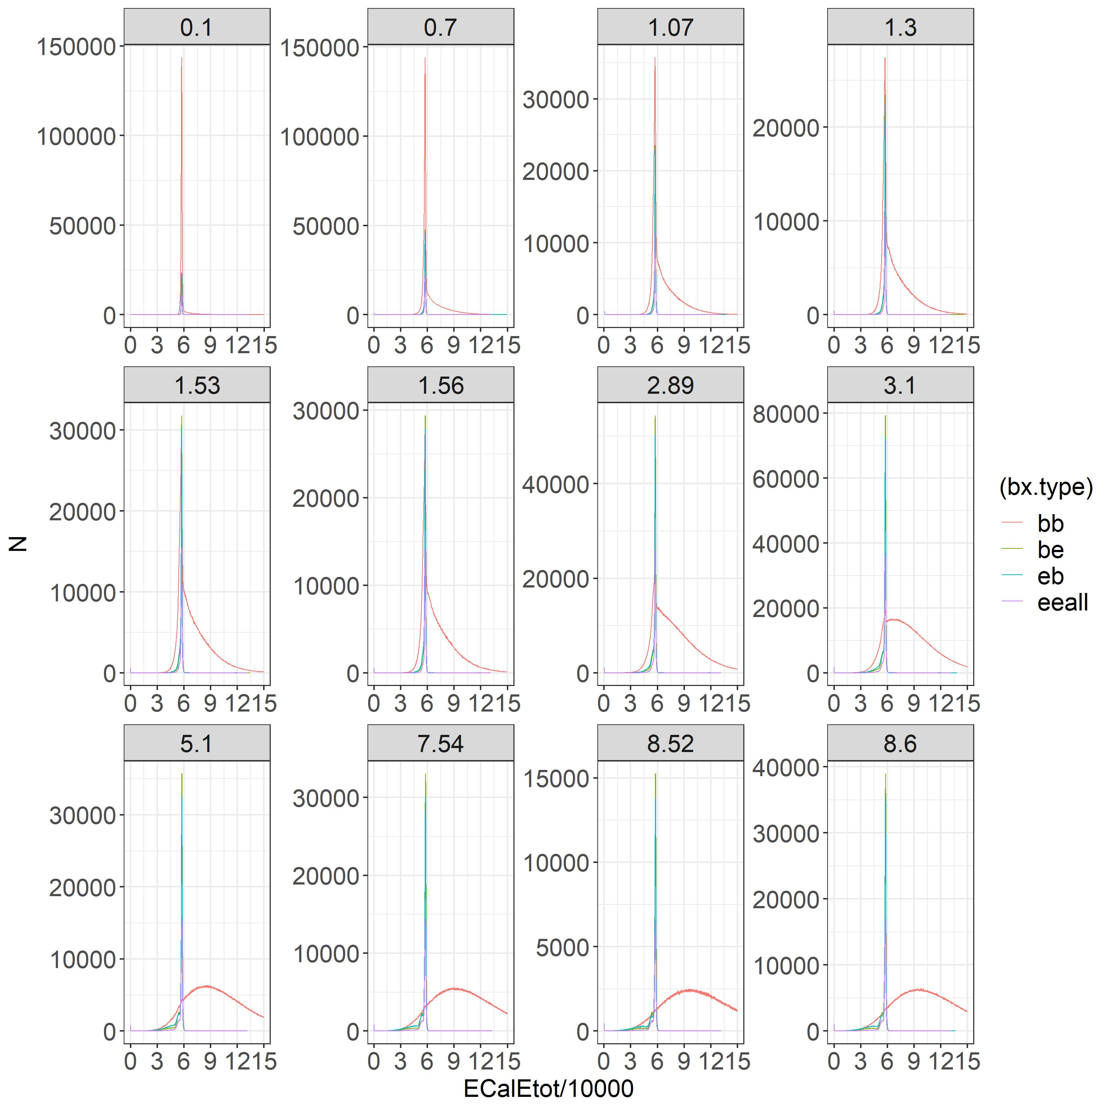
ECalEtot Spectrum for May MuScan
Same issue as ECalET

Slide 5
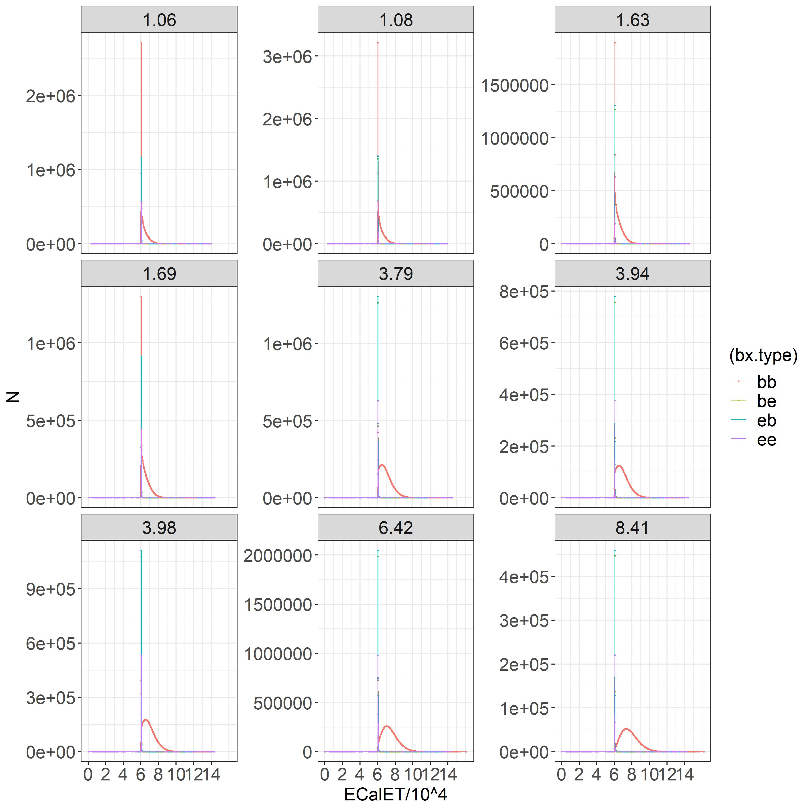
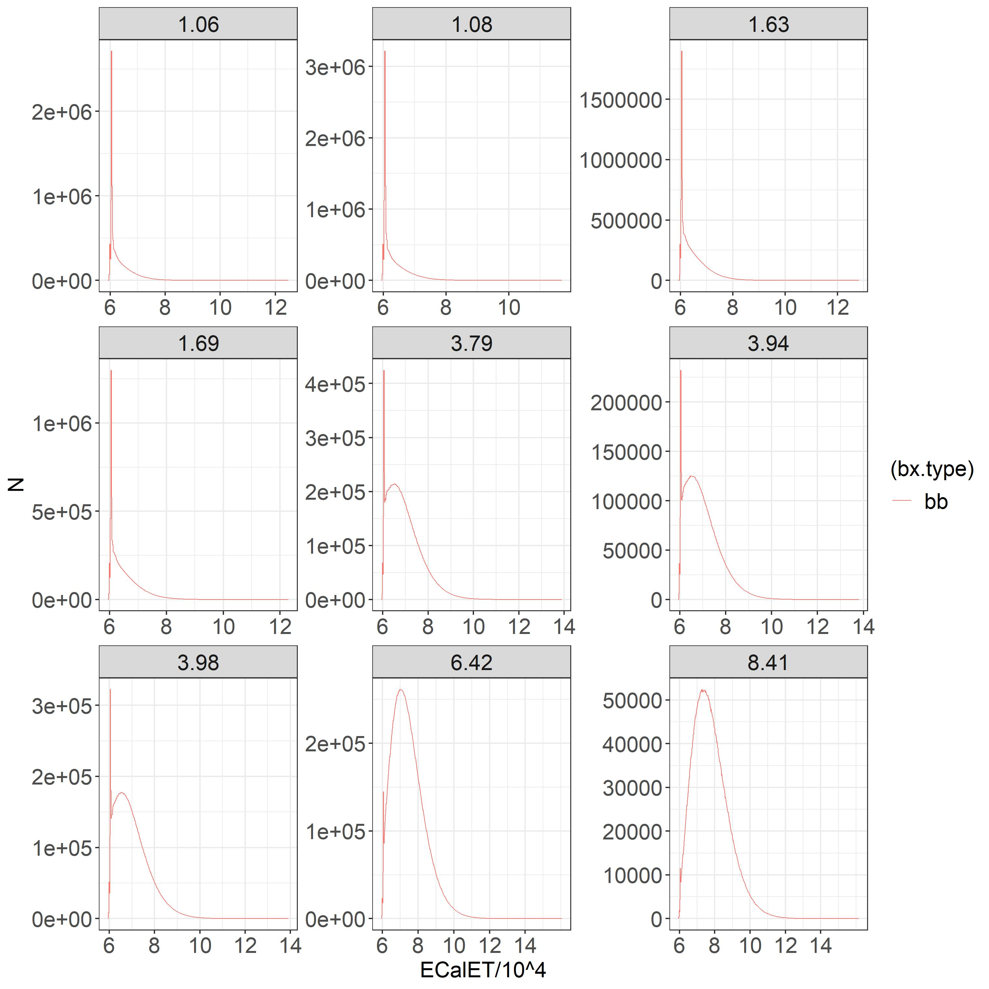
ECalET Spectrum for June MuScan
No ‘negative tail’ for bb (but still exists for ee)
bb Signal starts at a certain value for all mu

Slide 6
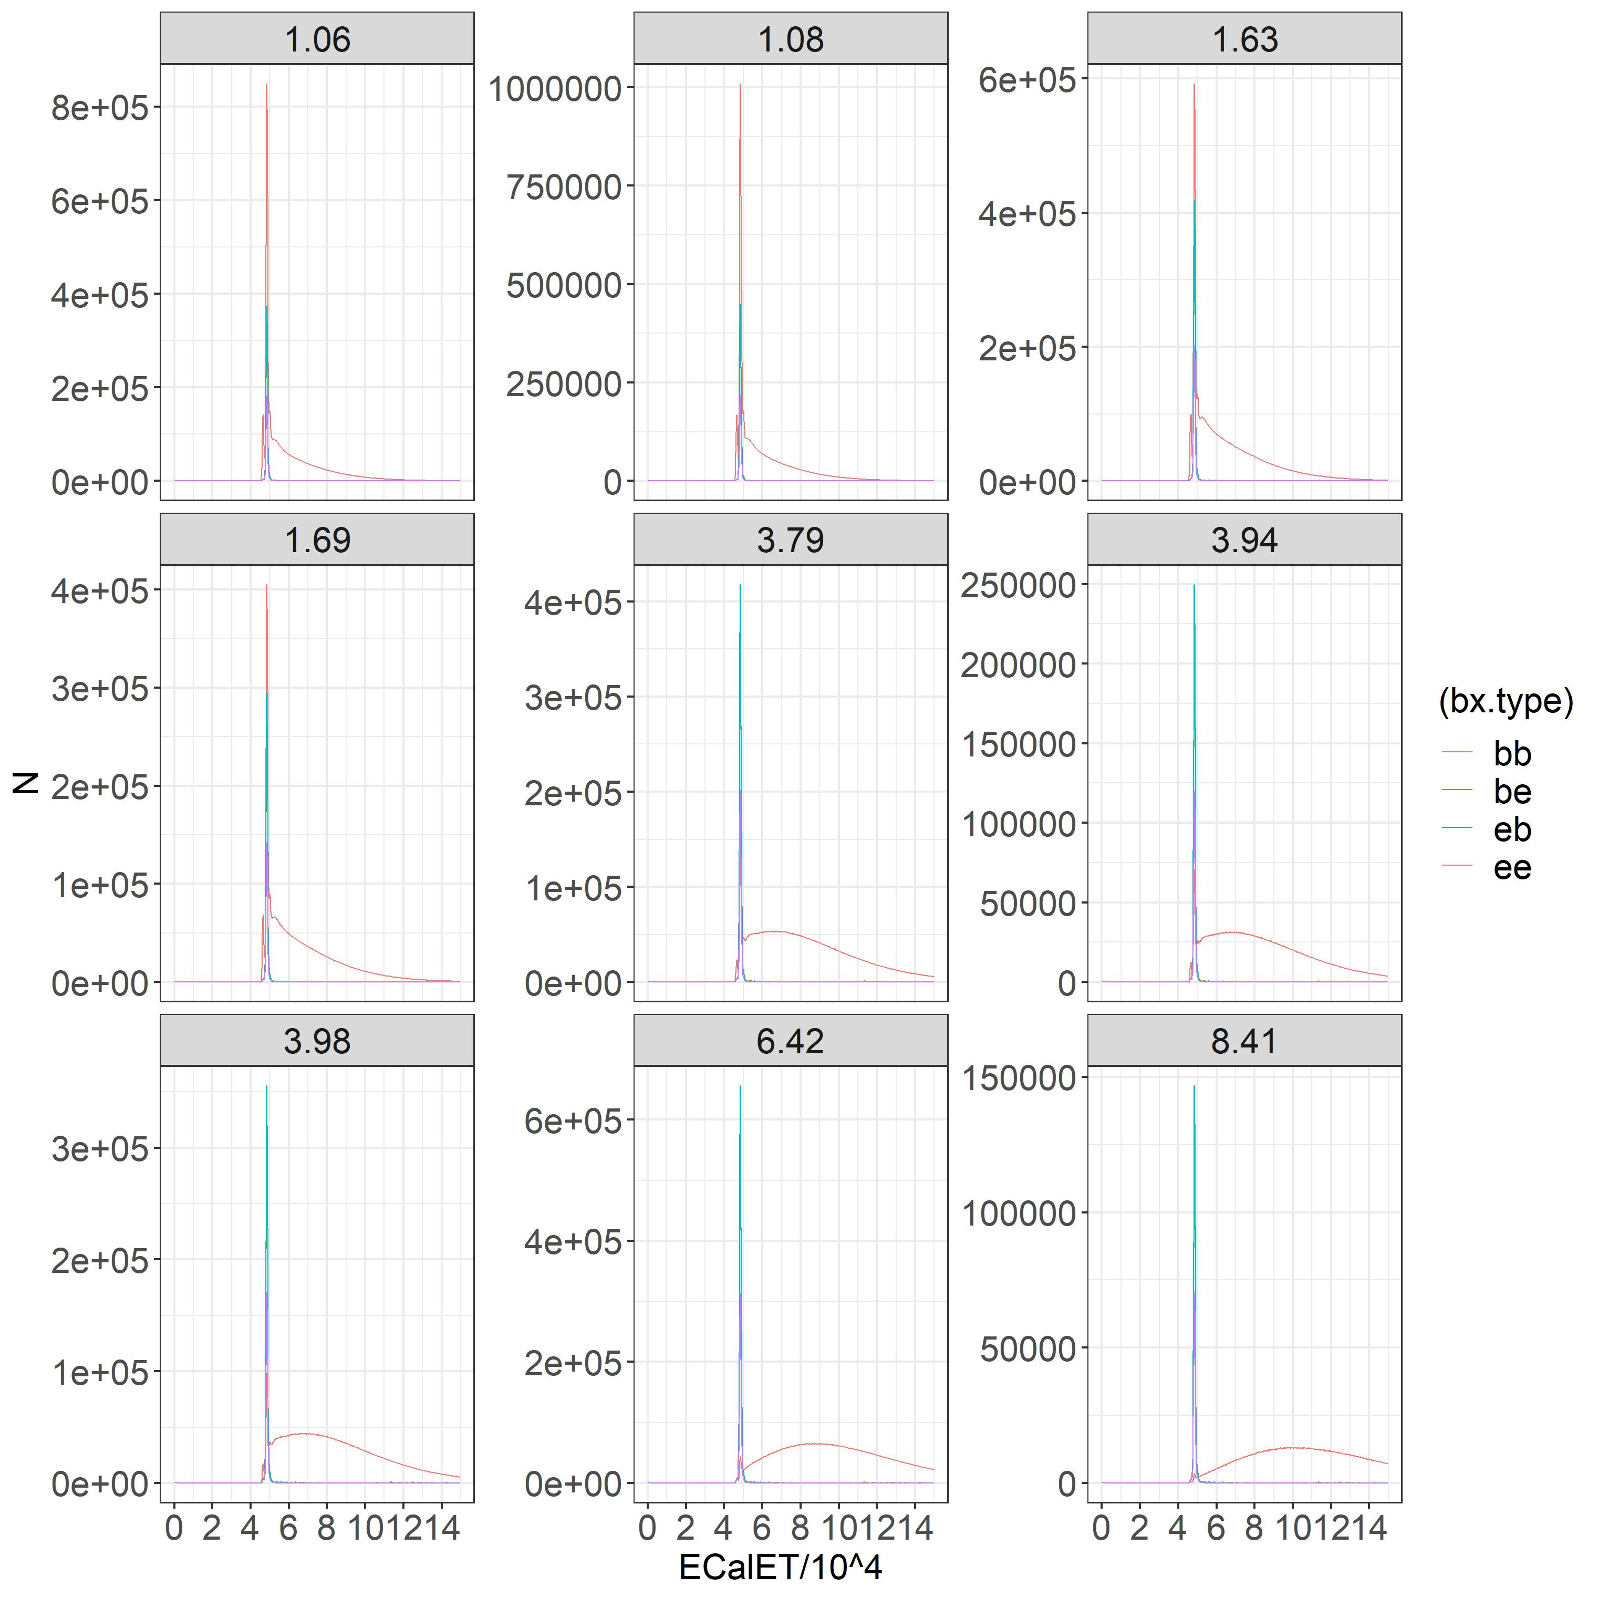
June Mu Scan EcalEtot Spectrum
Similar to EcalET (of June)

Slide 7
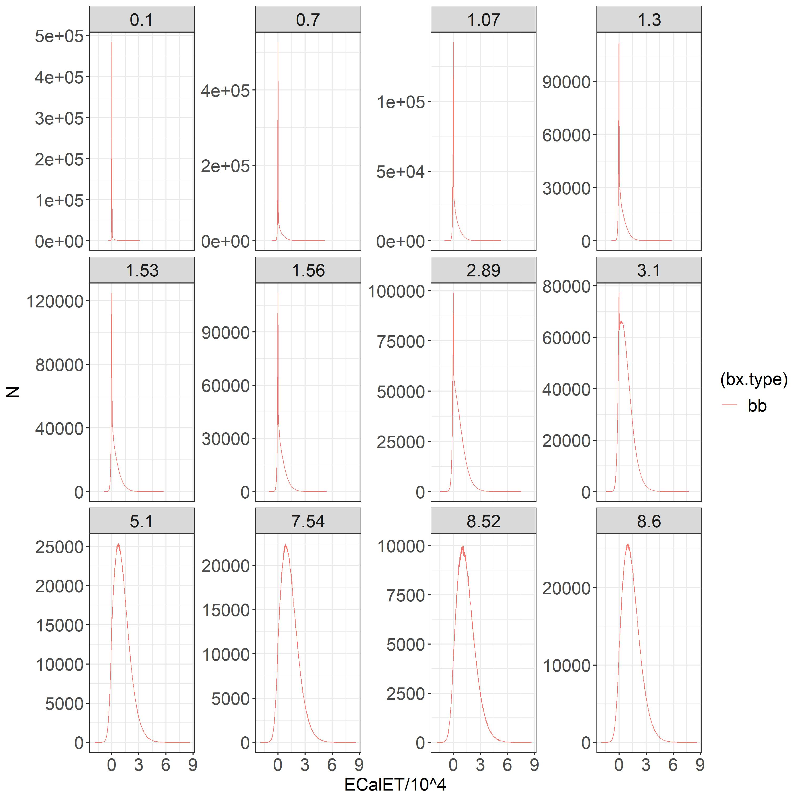
Method
Compare the bb signal ‘left’ of the peak and the ‘right’ of the peak:
Shift the signal to zero.
Take the average of the signal from the left and the right.

Slide 8
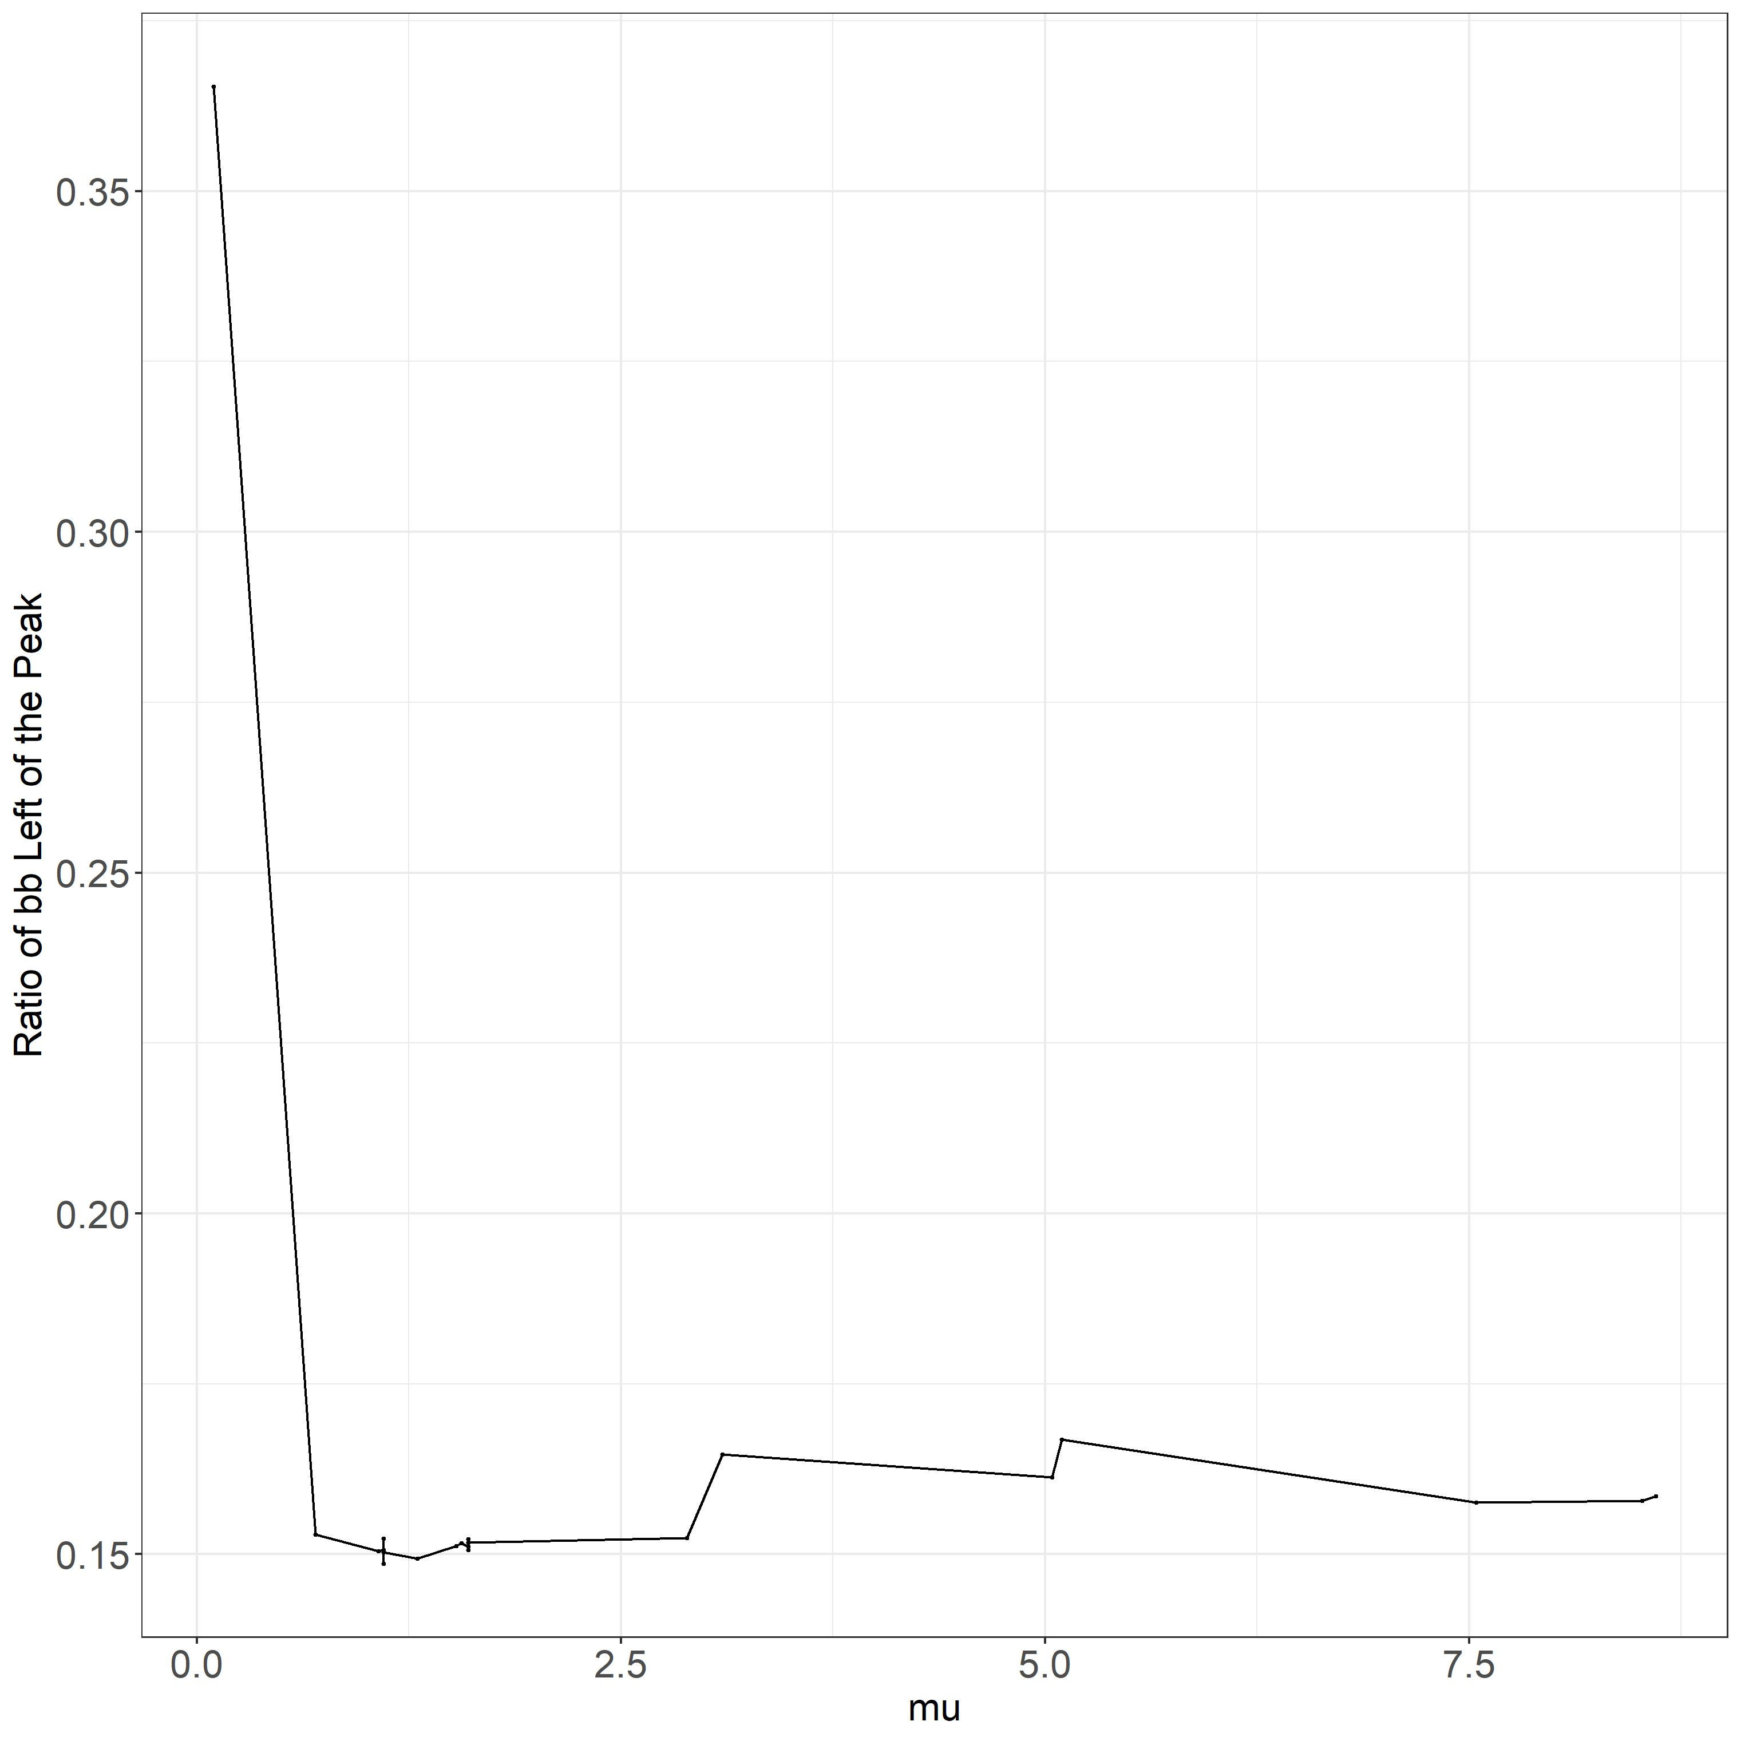
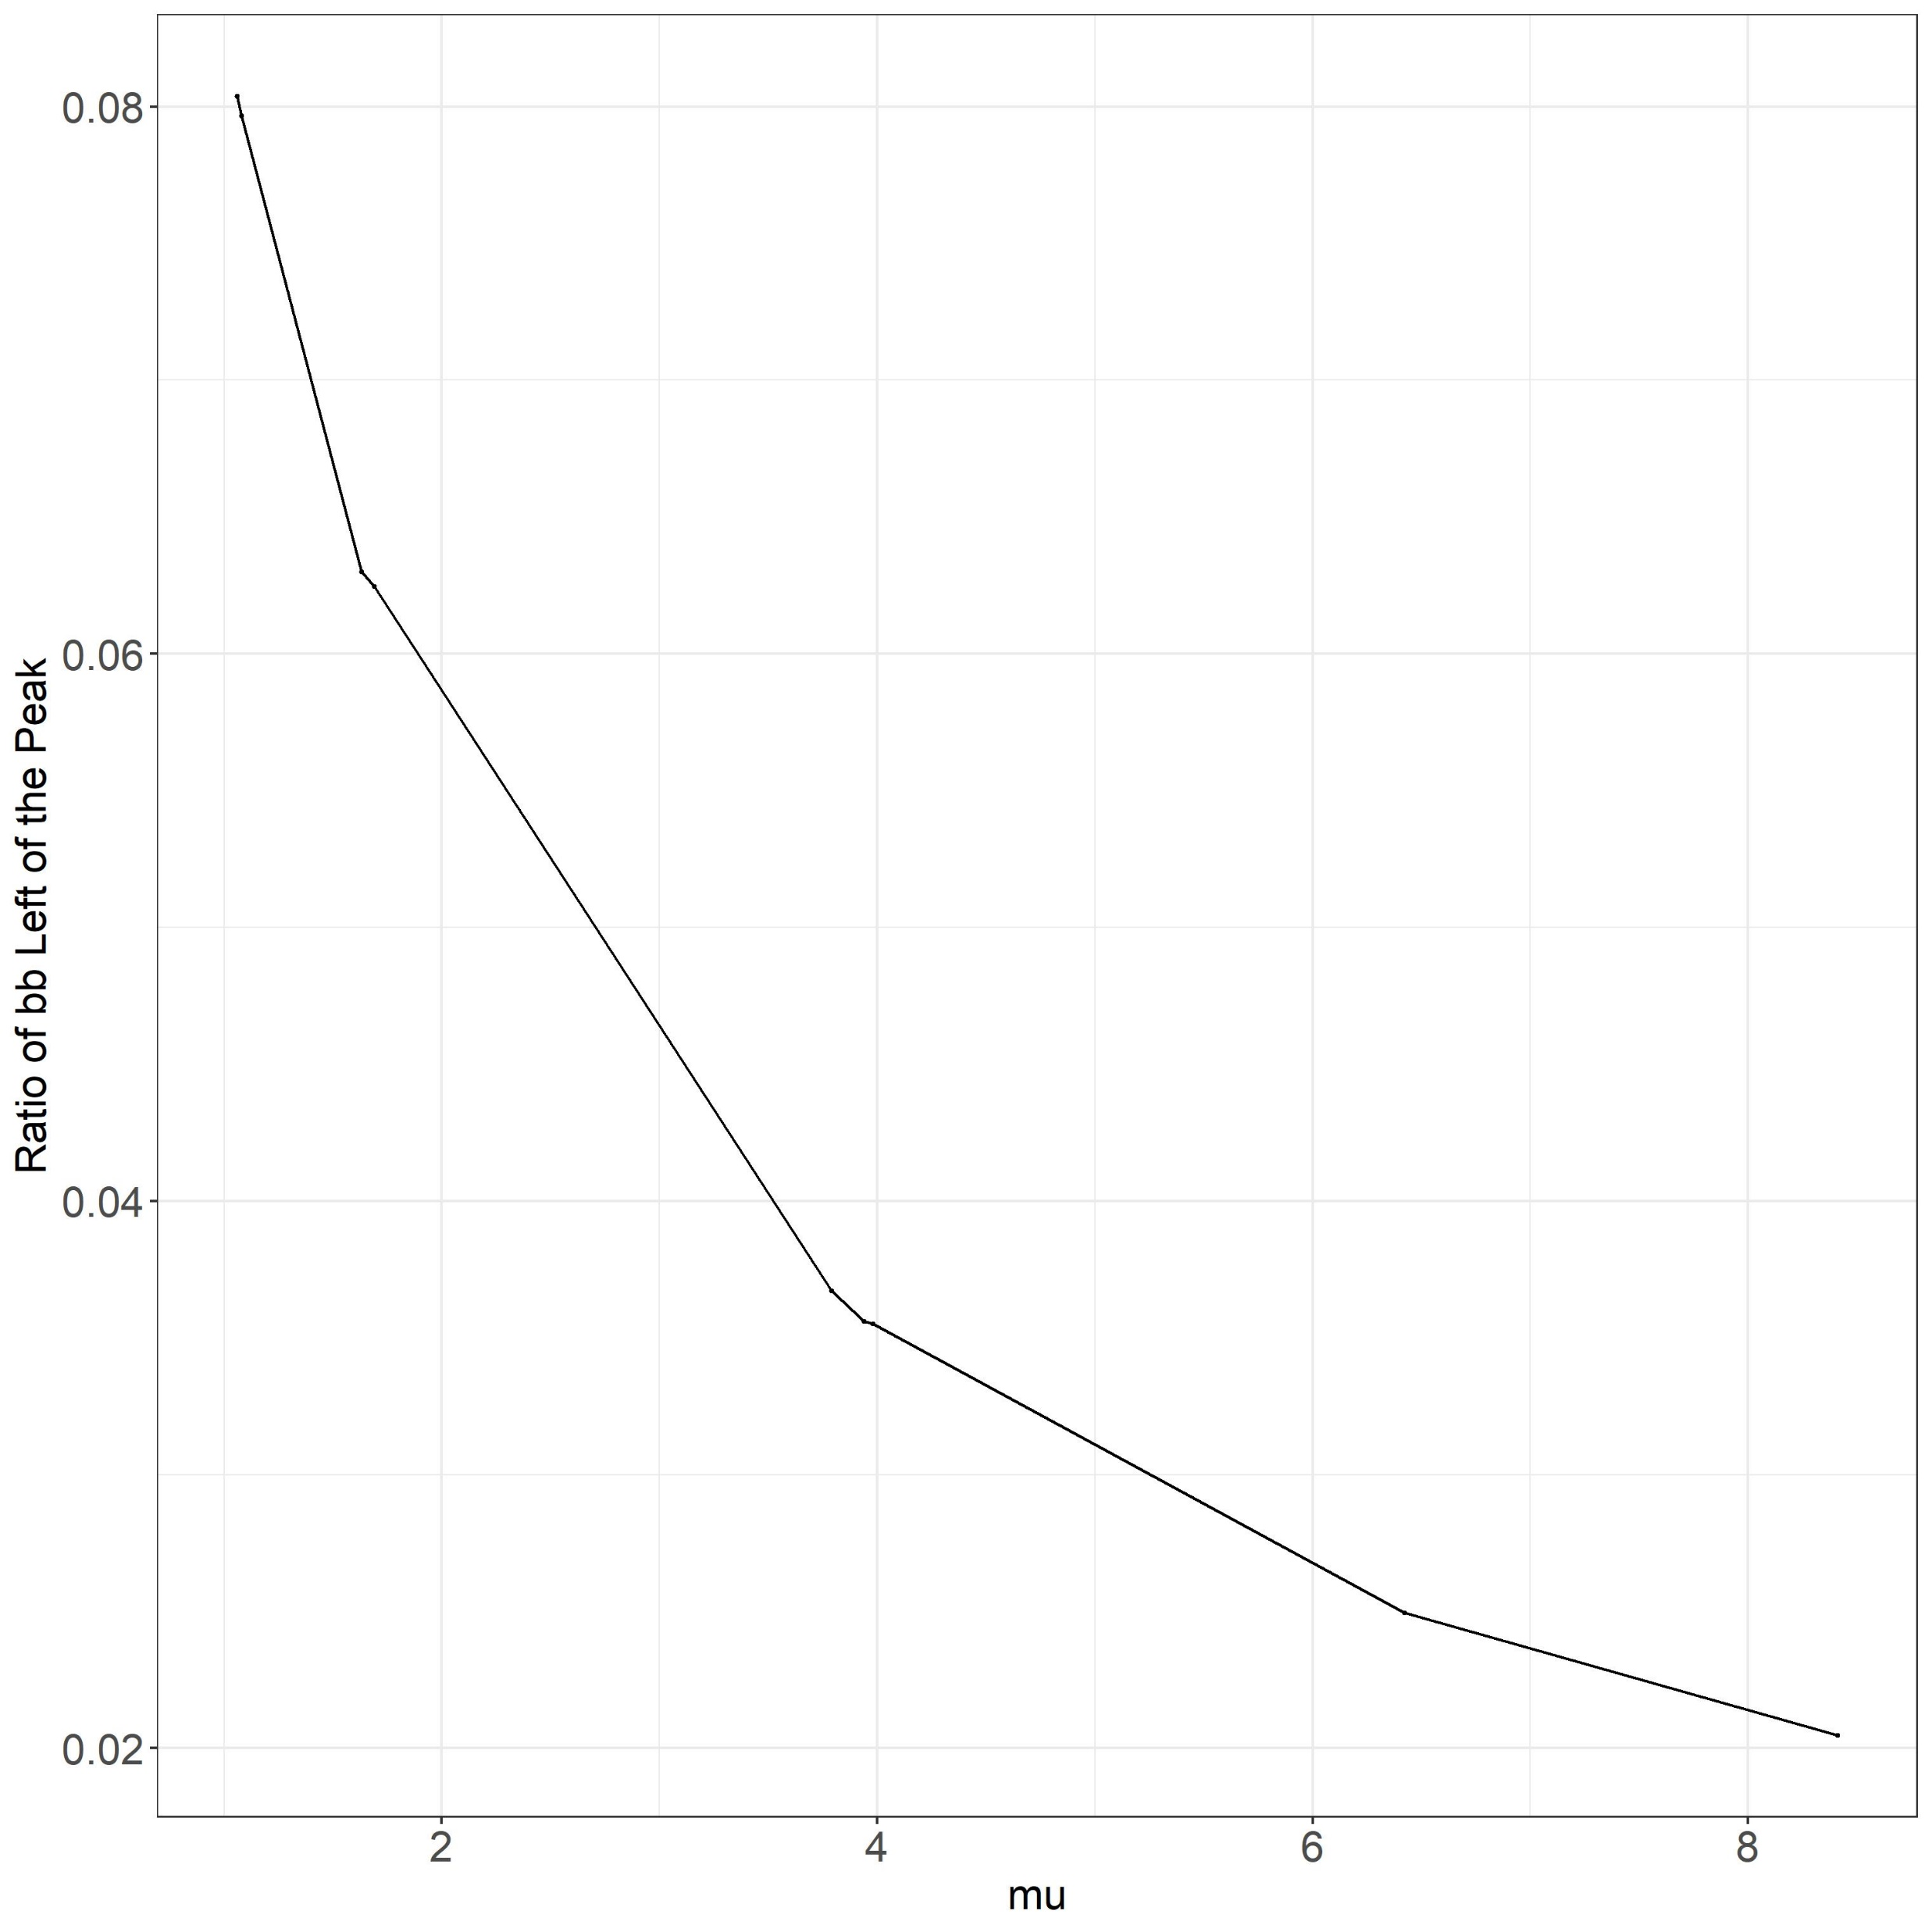
Ratio of left signal w.r.t. the right (left signal/right signal)
May
June

Slide 9
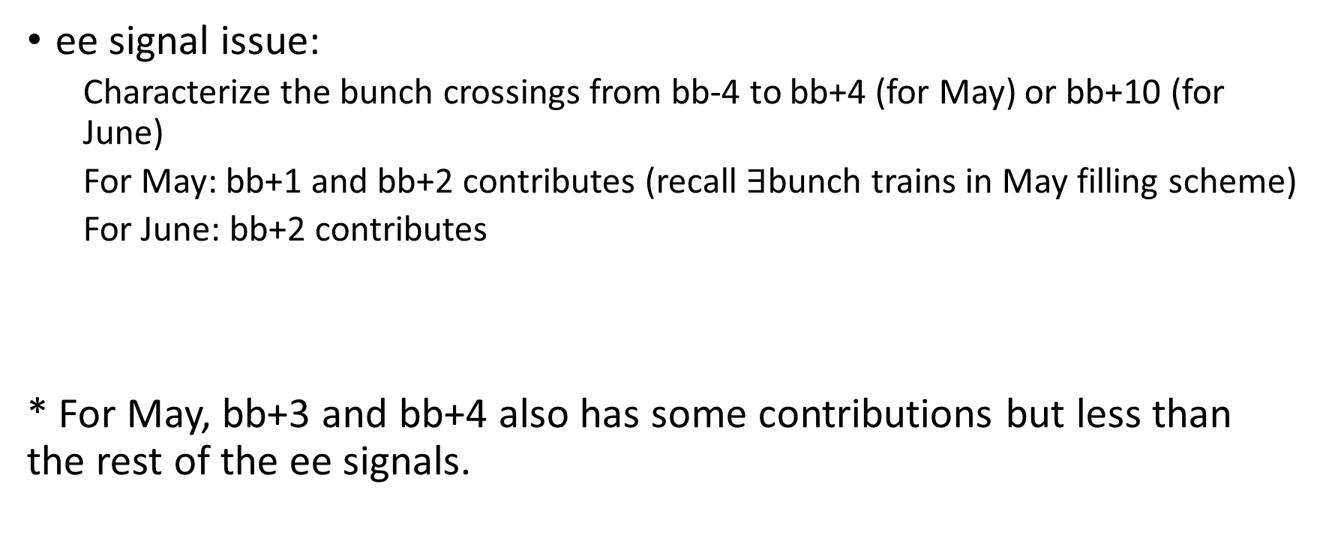
Method
ee signal issue:
Characterize the bunch crossings from bb-4 to bb+4 (for May) or bb+10 (for June)
For May: bb+1 and bb+2 contributes (recall $∃$bunch trains in May filling scheme)
For June: bb+2 contributes
* For May, bb+3 and bb+4 also has some contributions but less than the rest of the ee signals.

Slide 10
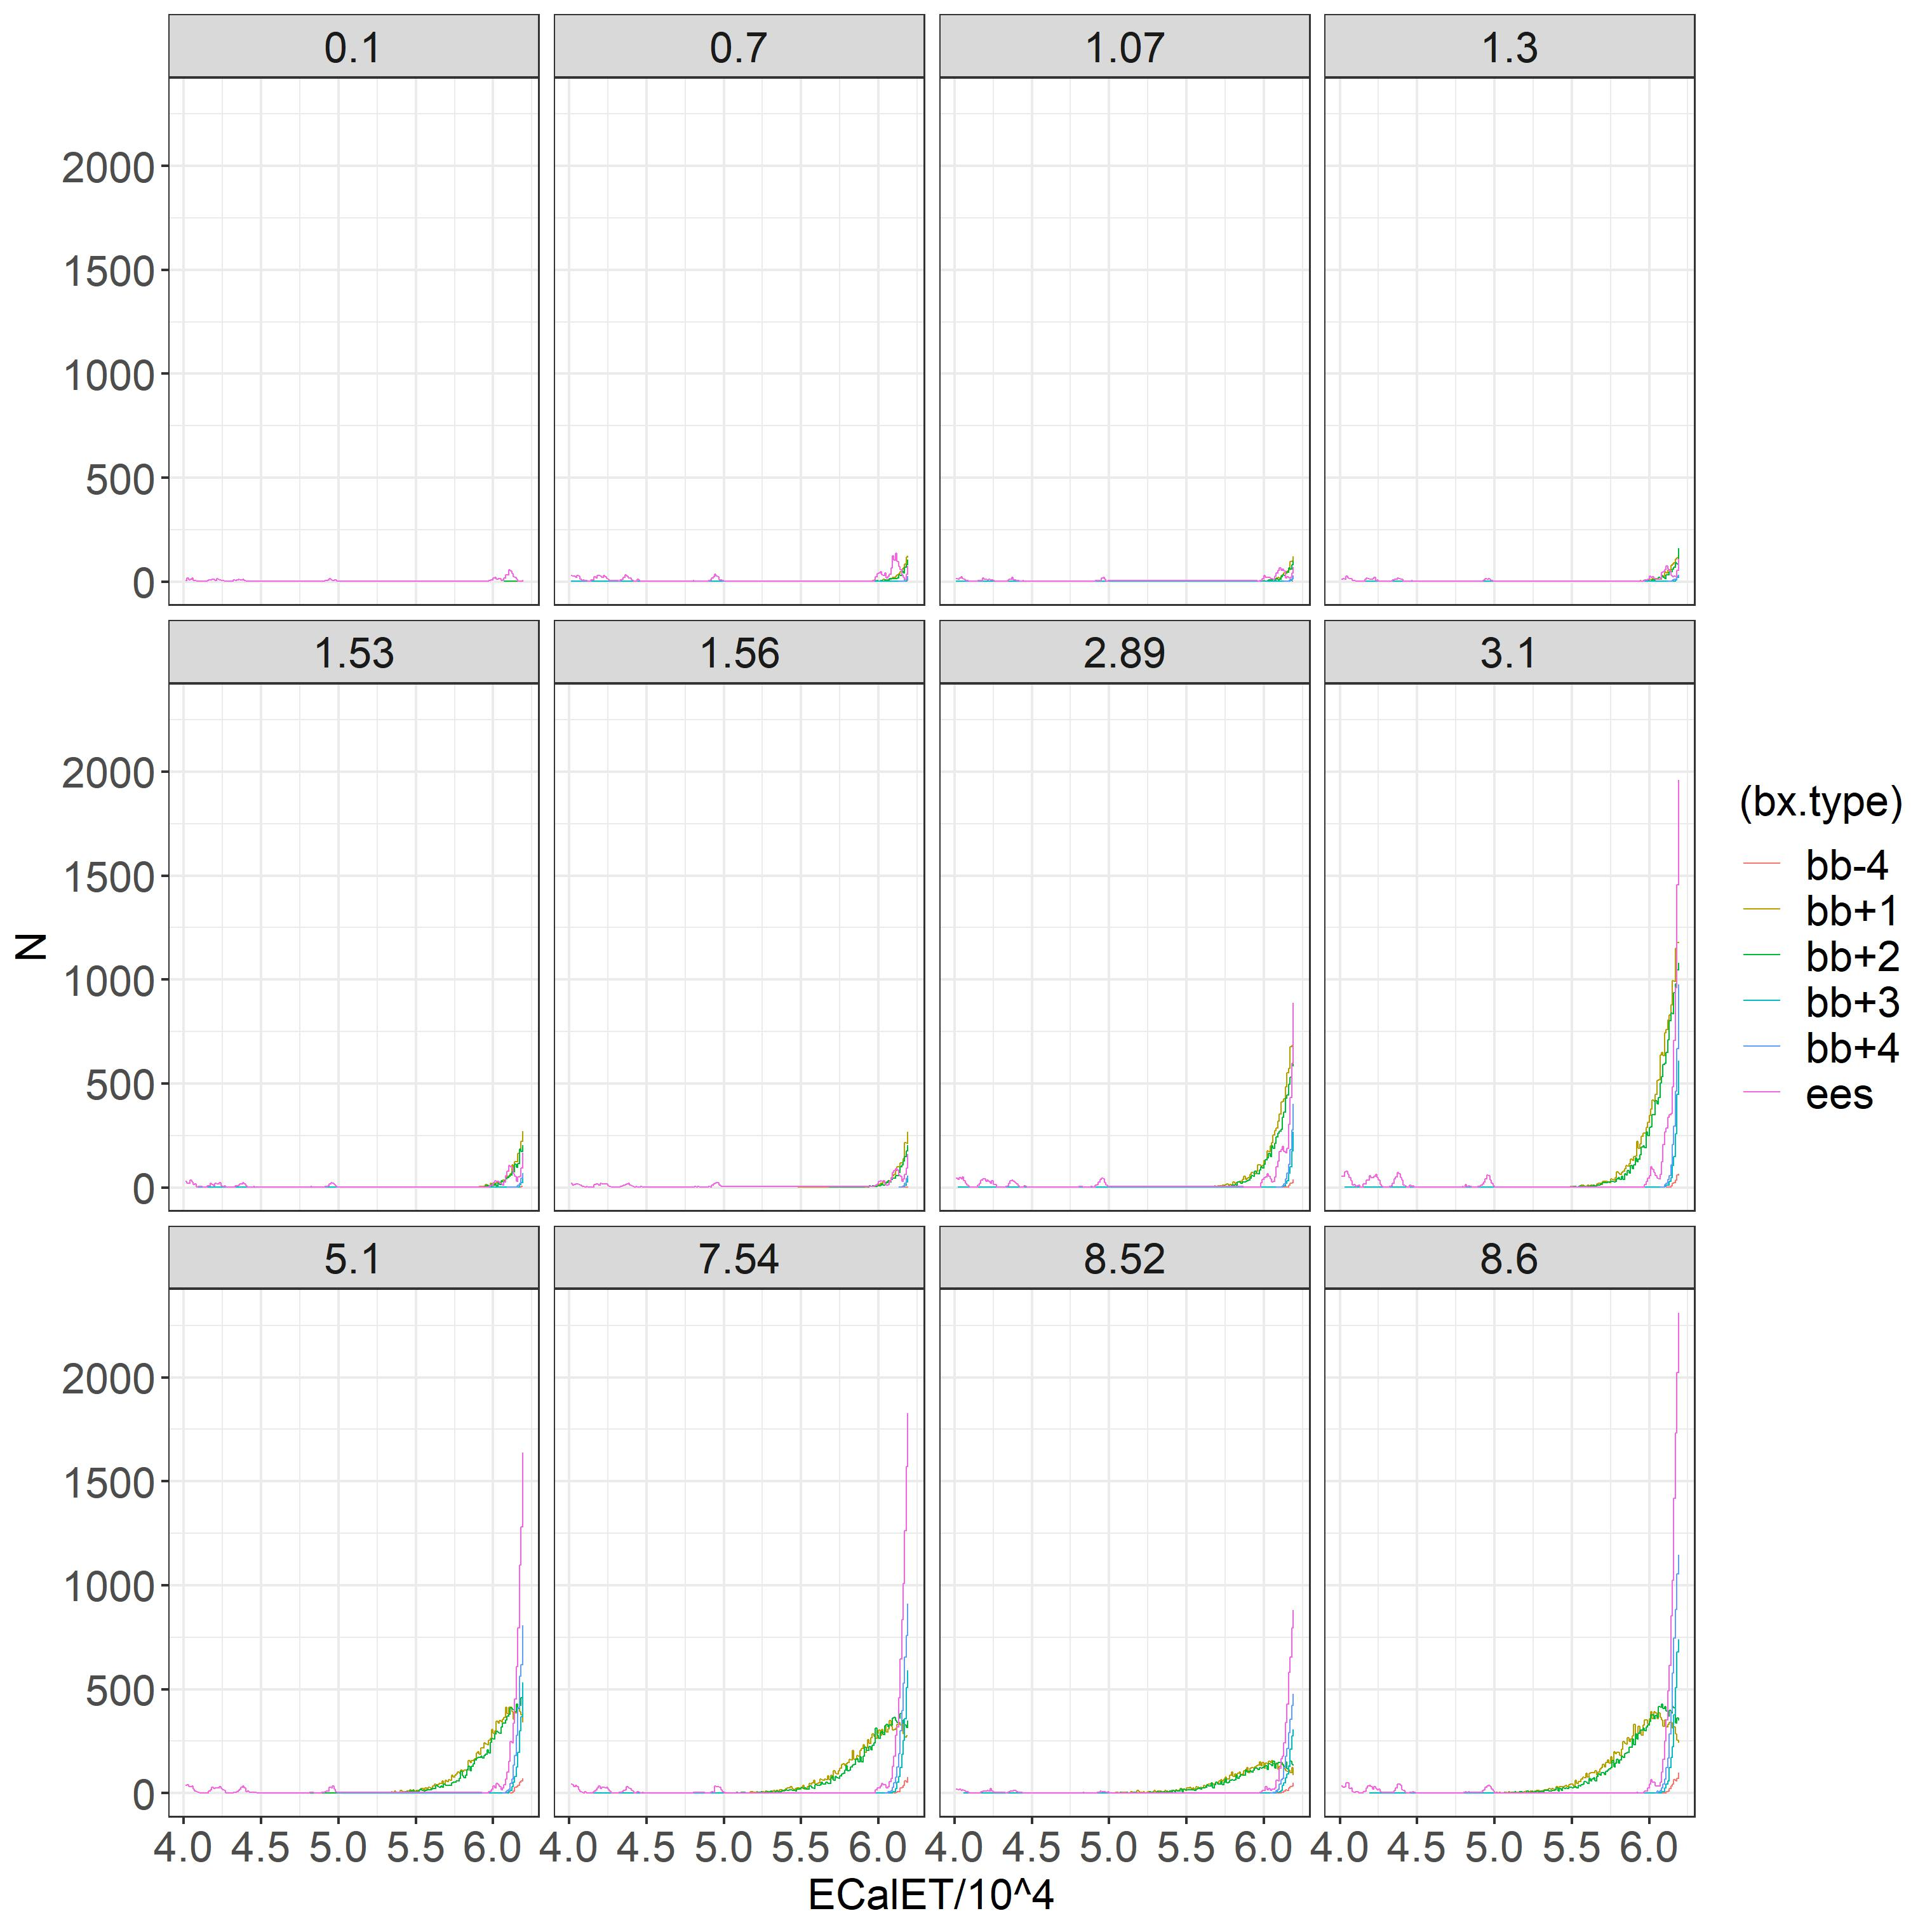
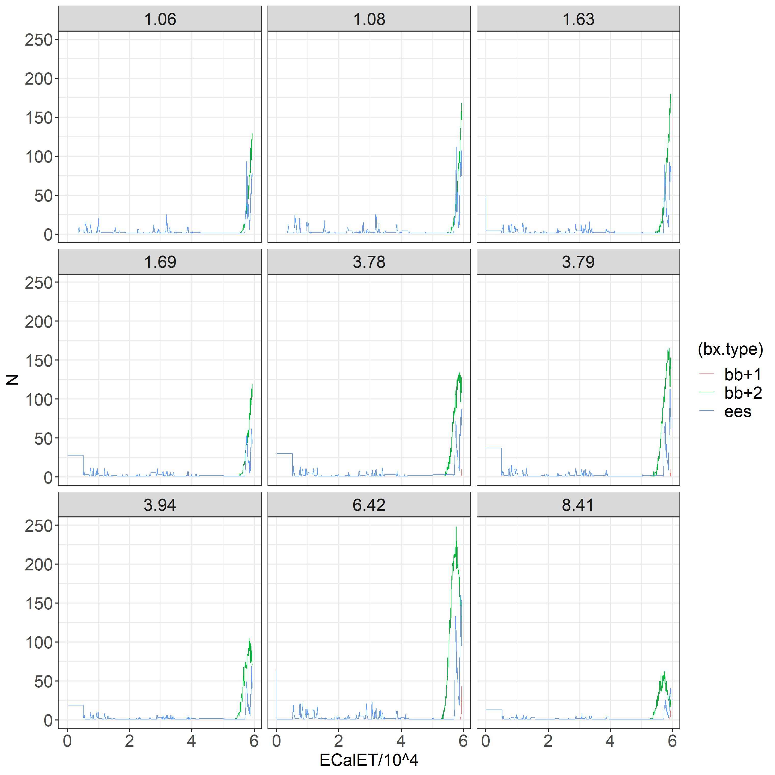
(Characterized) ee spectrum below cut
May
June

Slide 11
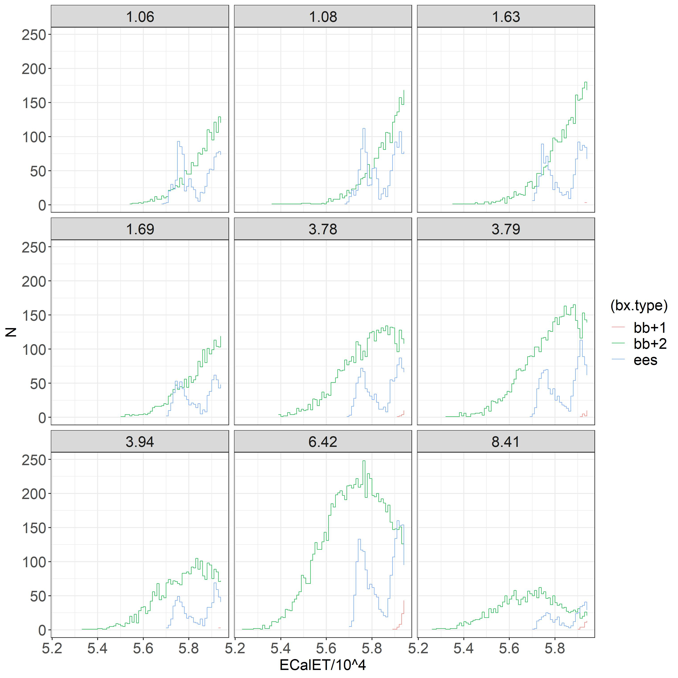
bb+2 and ee spectrum for June

Slide 12
More on ee signal left of the cut
Except for the 16 bb+2 signals between ~52000 and ~59000:
The signals below ~52000 are from 3 ee bunch crossings (out of 3300):
89, 110, 131
The signals between ~52000 and ~59000 are from 2 ee bunch crossings:
92, 134
They are likely not Beam Dumps.
This looks strange.
And the reason is not clear.
However, if we can resolve it or have an
explanation, then the only contribution
below the cut for ee would be only from
bb+2.

Slide 13
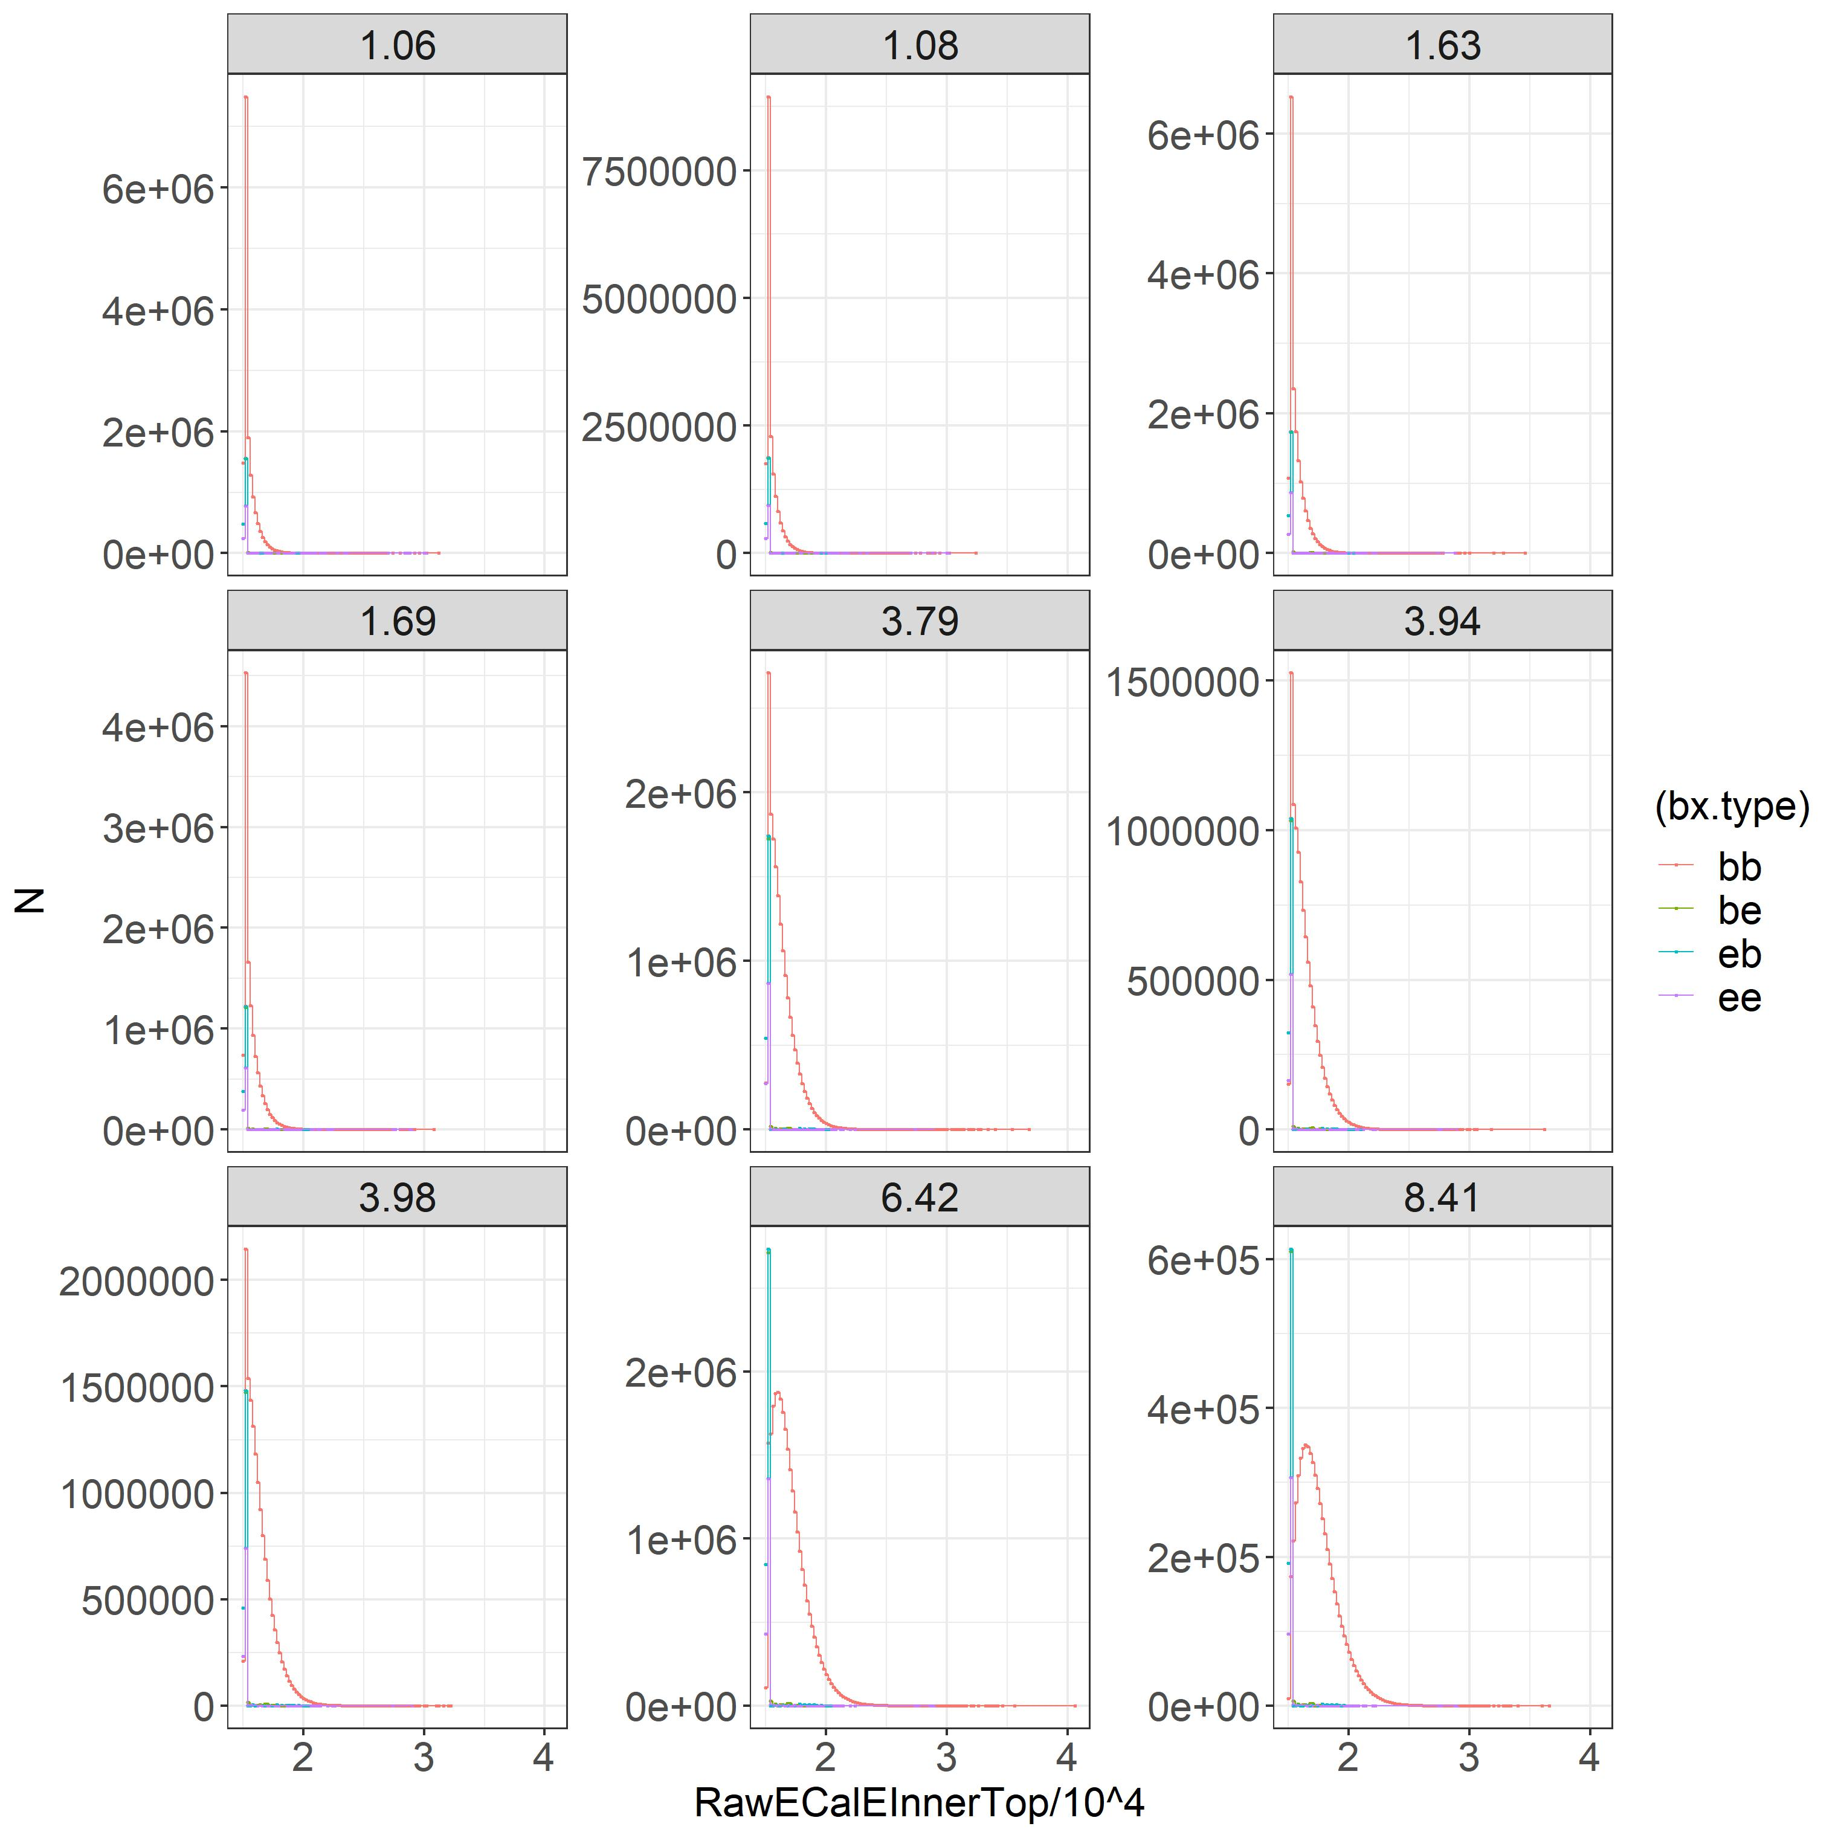
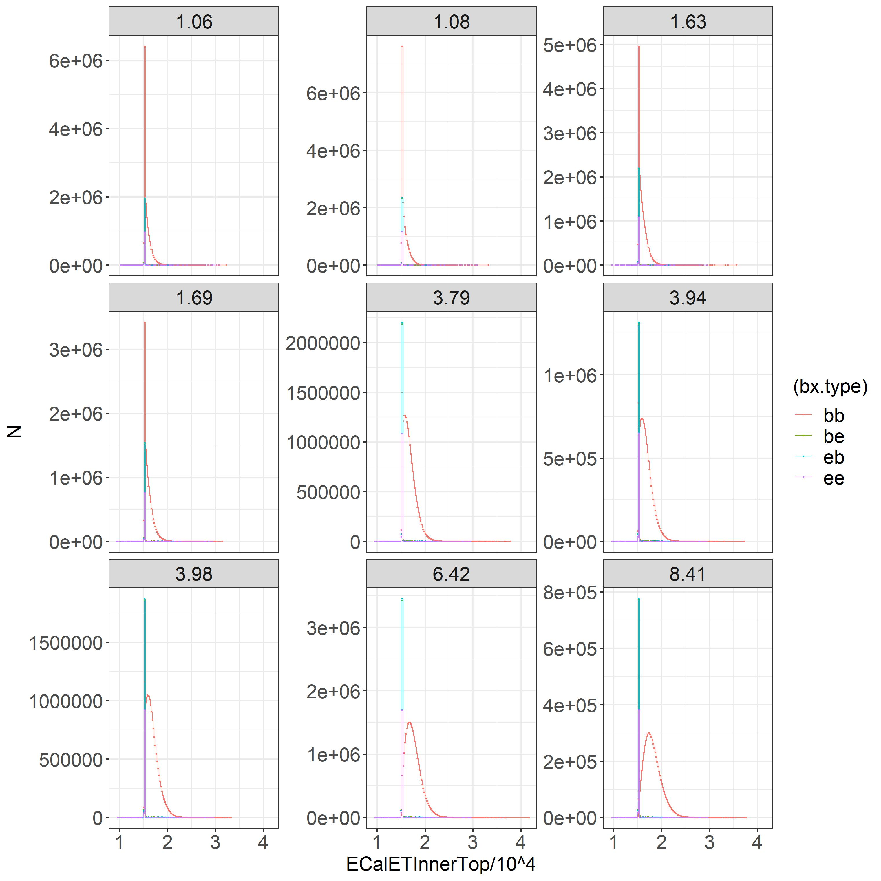
RawEcal Analyzed for June MuScan

Slide 14
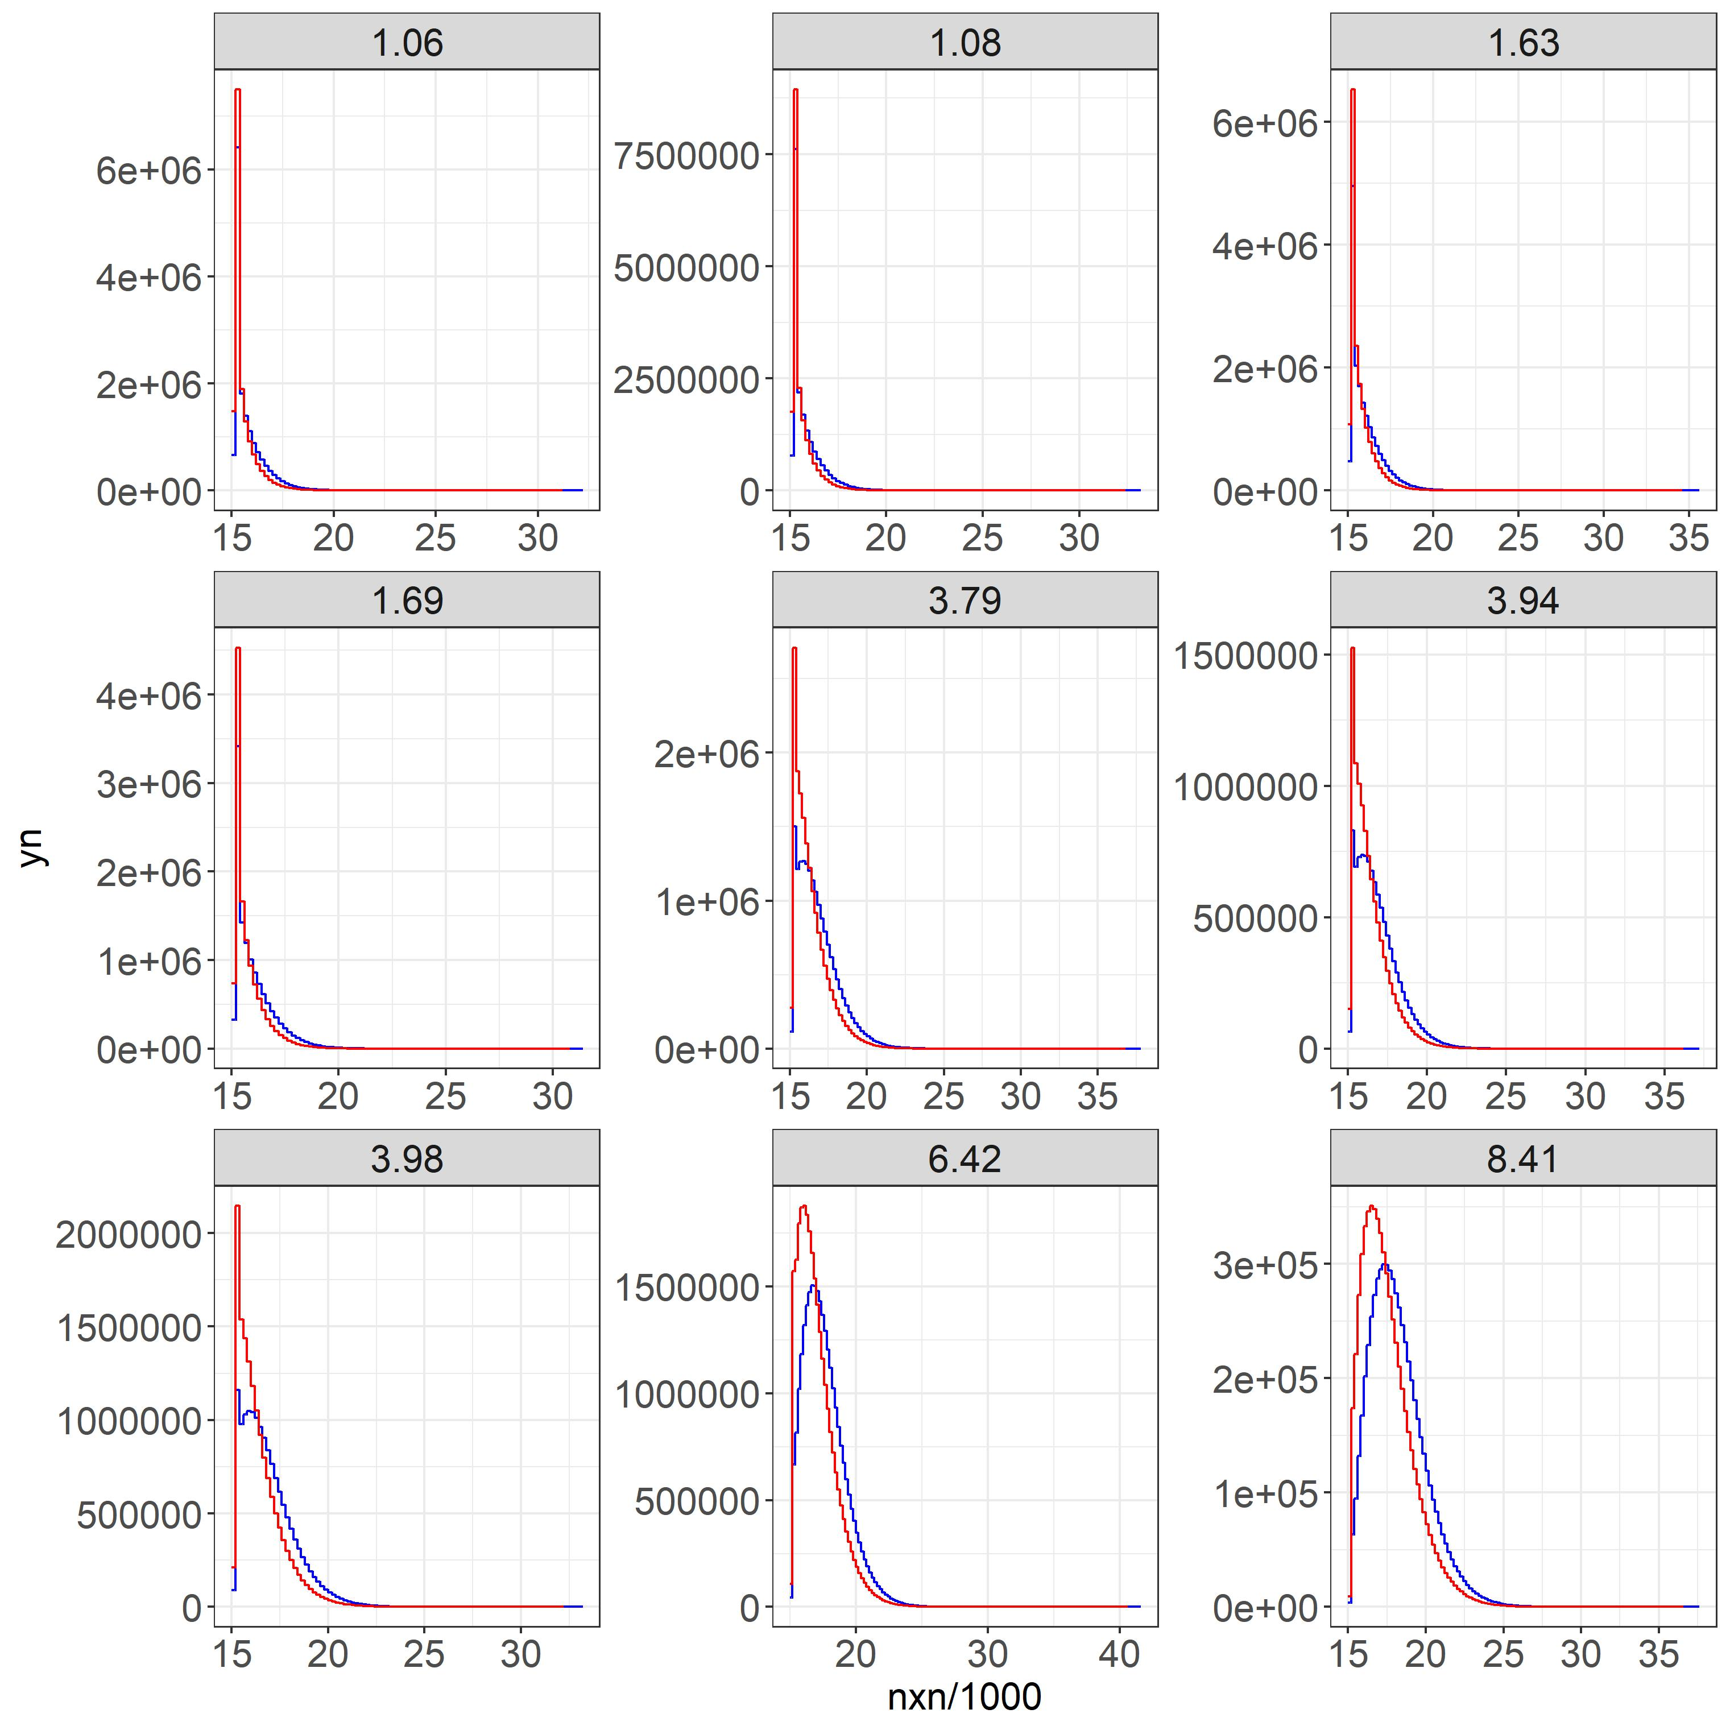
RawECal and Ecal spectrum extrapolated
Red: RawECalEInnterTop
Blue: ECalETInnerTop
The Spectrums are a bit different

Slide 15
Takeaways
ECals from May MuScan has negative tails -> issue w/ pedestal subtraction.
June MuScan has negative tails only in ees -> caused by bb+2
The algorithm in HLT Lumi Summary has probably been changed. (LHCb-INT-2019-004.pdf (cern.ch))
The newer algorithm seems better since better pedestal subtraction + more consistent bb+2 bias.
RawECal data is available for June.
There are slight discrepancies between the HLT1 Lumi Summary spectrum and the Raw spectrum.

Slide 16
Additional Slide(s)

Slide 17
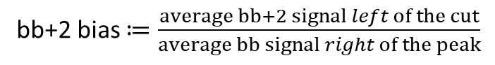
June May
Bias in bb+2
mu | bb+2
1.06 | -0.176158979
1.08 | -0.173411903
1.63 | -0.199865959
1.69 | -0.193859262
3.79 | -0.215512362
3.94 | -0.219098458
6.42 | -0.210769857
8.41 | -0.197317974
mu | bb+2 bias
0.1 | -0.153419833
0.7 | -0.117689007
1.07 | -0.127724942
1.1 | -0.127769733
1.1 | -0.126344142
1.1 | -0.124762771
1.1 | -0.123370729
1.3 | -0.132508028
1.53 | -0.136172754
1.56 | -0.136682871
1.6 | -0.136463276
1.6 | -0.13602448
1.6 | -0.138348484
1.6 | -0.137903626
2.89 | -0.16031987
3.1 | -0.173538082
5.04 | -0.187552081
5.1 | -0.201856534
7.54 | -0.21371235
8.52 | -0.225963719
8.6 | -0.218139629
bb+2 bias $≔\frac{average bb+2 signal left of the cut}{average bb signal right of the peak}$
The bias in May increases w/ mu
The bias in June increases w/ mu but not as much as in May

